Slide 1
Introducing the AWT: Working with Windows, Graphics and Text …
Anisha P Rodrigues, Dept of CSE, NMAMIT, Nitte

Slide 2
The AWT (Abstract Window Toolkit) contains numerous classes and methods that allow you to create and manage windows
Anisha P Rodrigues, Dept of CSE, NMAMIT, Nitte

Slide 3
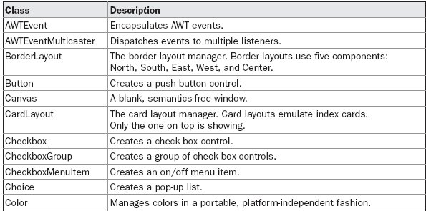
AWT Classes…
Anisha P Rodrigues, Dept of CSE, NMAMIT, Nitte

Slide 4
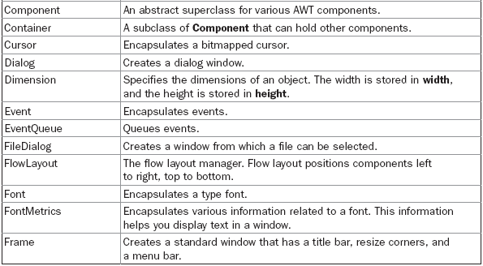
Anisha P Rodrigues, Dept of CSE, NMAMIT, Nitte

Slide 5
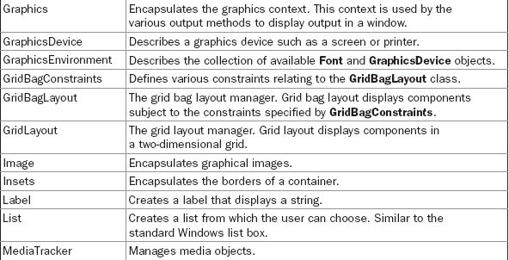
Anisha P Rodrigues, Dept of CSE, NMAMIT, Nitte

Slide 6
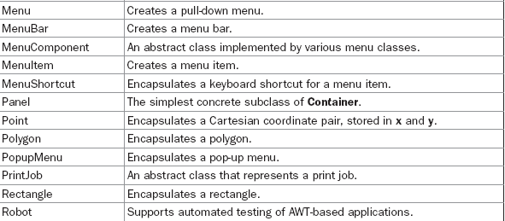
Anisha P Rodrigues, Dept of CSE, NMAMIT, Nitte

Slide 7
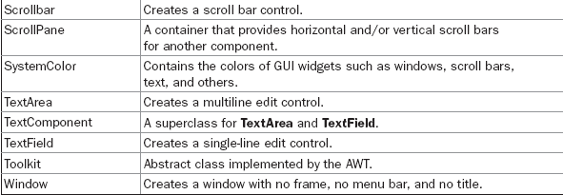
Anisha P Rodrigues, Dept of CSE, NMAMIT, Nitte

Slide 8
Window Fundamentals…
The two most common windows are those derived from Panel, which is used by applets, and those derived from Frame, which creates a standard application window
Much of the functionality of these windows is derived from their parent classes
Anisha P Rodrigues, Dept of CSE, NMAMIT, Nitte

Slide 9
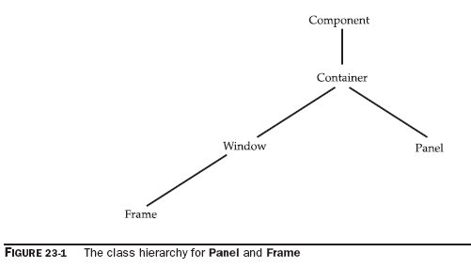
Anisha P Rodrigues, Dept of CSE, NMAMIT, Nitte

Slide 10
Component…
At the top of the AWT hierarchy is the Component class
Component is an abstract class that encapsulates all of the attributes of a visual component
Anisha P Rodrigues, Dept of CSE, NMAMIT, Nitte

Slide 11
All user interface elements that are displayed on the screen and that interact with the user are subclasses of Component
It defines over a hundred public methods that are responsible for managing events, such as mouse and keyboard input, positioning and sizing the window, and repainting
Anisha P Rodrigues, Dept of CSE, NMAMIT, Nitte

Slide 12
A Component object is responsible for remembering the current foreground and background colors and the currently selected text font
Anisha P Rodrigues, Dept of CSE, NMAMIT, Nitte

Slide 13
Container…
The Container class is a subclass of Component
It has additional methods that allow other Component objects to be nested within it
Other Container objects can be stored inside of a Container
This makes for a multileveled containment system
Anisha P Rodrigues, Dept of CSE, NMAMIT, Nitte

Slide 14
Panel…
The Panel class is a concrete subclass of Container
It doesn’t add any new methods; it simply implements Container
A Panel may be thought of as a recursively nestable, concrete screen component
Anisha P Rodrigues, Dept of CSE, NMAMIT, Nitte

Slide 15
Panel is the superclass for Applet
When screen output is directed to an applet, it is drawn on the surface of a Panel object
In essence, a Panel is a window that does not contain a title bar, menu bar, or border
Anisha P Rodrigues, Dept of CSE, NMAMIT, Nitte

Slide 16
Other components can be added to a Panel object by its add() method (inherited from Container)
Once these components have been added, you can position and resize them manually using the setLocation(), setSize(), setPreferredSize(), or setBounds() methods defined by Component
Anisha P Rodrigues, Dept of CSE, NMAMIT, Nitte

Slide 17
Window…
The Window class creates a top-level window
A top-level window is not contained within any other object; it sits directly on the desktop
Generally, we won’t create Window objects directly
Instead, we will use a subclass of Window called Frame
Anisha P Rodrigues, Dept of CSE, NMAMIT, Nitte

Slide 18
Frame…
It is a subclass of Window and has a title bar, menu bar, borders, and resizing corners
If you create a Frame object from within an applet, it will contain a warning message, such as “Java Applet Window,” to the user that an applet window has been created
This message warns users that the window they see was started by an applet and not by software running on their computer
Anisha P Rodrigues, Dept of CSE, NMAMIT, Nitte

Slide 19
An applet that could masquerade as a host-based application could be used to obtain passwords and other sensitive information without the user’s knowledge!!!
Anisha P Rodrigues, Dept of CSE, NMAMIT, Nitte

Slide 20
When a Frame window is created by a stand-alone application rather than an applet, a normal window is created
Anisha P Rodrigues, Dept of CSE, NMAMIT, Nitte

Slide 21
Canvas…
Canvas encapsulates a blank window upon which we can draw…
Anisha P Rodrigues, Dept of CSE, NMAMIT, Nitte

Slide 22
Working with Frame Windows…
After the applet, the type of window we most often create is derived from Frame
We use it to create child windows within applets, and top-level or child windows for stand-alone applications
Anisha P Rodrigues, Dept of CSE, NMAMIT, Nitte

Slide 23
Here are two of Frame’s constructors:
Frame( )
Frame(String title)
The first form creates a standard window that does not contain a title
The second form creates a window with the title specified by title
Anisha P Rodrigues, Dept of CSE, NMAMIT, Nitte

Slide 24
Notice that we cannot specify the dimensions of the window; Instead, we must set the size of the window after it has been created…
Anisha P Rodrigues, Dept of CSE, NMAMIT, Nitte

Slide 25
Setting the Window’s Dimensions:
The setSize( ) method is used to set the dimensions of the window
void setSize(int newWidth, int newHeight)
void setSize(Dimension newSize)
The new size of the window is specified by newWidth and newHeight, or by the width and height fields of the Dimension object passed in newSize
Anisha P Rodrigues, Dept of CSE, NMAMIT, Nitte

Slide 26
The dimensions are specified in terms of pixels
The getSize( ) method is used to obtain the current size of a window
Dimension getSize( )
This method returns the current size of the window contained within the width and height fields of a Dimension object
Anisha P Rodrigues, Dept of CSE, NMAMIT, Nitte

Slide 27
Hiding and Showing a Window:
After a frame window has been created, it will not be visible until you call setVisible( )
void setVisible(boolean visibleFlag)
The component is visible if the argument to this method is true
Otherwise, it is hidden
Anisha P Rodrigues, Dept of CSE, NMAMIT, Nitte

Slide 28
Setting a Window’s Title:
We can change the title in a frame window using setTitle( ), which has this general form:
void setTitle(String newTitle)
Here, newTitle is the new title for the window.
Anisha P Rodrigues, Dept of CSE, NMAMIT, Nitte

Slide 29
Closing a Frame Window:
When using a frame window, your program must remove that window from the screen when it is closed, by calling setVisible(false)
To intercept a window-close event, you must implement the windowClosing( ) method of the WindowListener interface
Inside windowClosing( ), you must remove the window from the screen
Anisha P Rodrigues, Dept of CSE, NMAMIT, Nitte

Slide 30
Creating a Frame Window in an Applet…
While it is possible to simply create a window by creating an instance of Frame, you will not be able to do much with it
For example, you will not be able to receive or process events that occur within it or easily output information to it
Most of the time, you will create a subclass of Frame
Doing so lets you override Frame’s methods and provide event handling
Anisha P Rodrigues, Dept of CSE, NMAMIT, Nitte

Slide 31
Creating a new frame window from within an applet:
First, create a subclass of Frame
Next, override any of the standard applet methods, such as init(), start(), and stop(), to show or hide the frame as needed
Finally, implement the windowClosing() method of the WindowListener interface, calling setVisible(false) when the window is closed
Anisha P Rodrigues, Dept of CSE, NMAMIT, Nitte

Slide 32
Once you have defined a Frame subclass, you can create an object of that class
This causes a frame window to come into existence, but it will not be initially visible
You make it visible by calling setVisible()
When created, the window is given a default height and width
You can set the size of the window explicitly by calling the setSize() method.
Anisha P Rodrigues, Dept of CSE, NMAMIT, Nitte

Slide 33
// Create a child frame window from within an applet.
import java.awt.*;
import java.awt.event.*;
import java.applet.*;
/* <applet code="AppletFrame" width=300 height=50> </applet> */
// Create a subclass of Frame.
class SampleFrame extends Frame {
SampleFrame(String title) {
super(title);
// create an object to handle window events
MyWindowAdapter adapter = new MyWindowAdapter(this);
// register it to receive those events
addWindowListener(adapter);
}
public void paint(Graphics g) {
g.drawString("This is in frame window", 10, 40);
}
}
Anisha P Rodrigues, Dept of CSE, NMAMIT, Nitte

Slide 34
class MyWindowAdapter extends WindowAdapter {
SampleFrame sampleFrame;
public MyWindowAdapter(SampleFrame sampleFrame) {
this.sampleFrame = sampleFrame;
}
public void windowClosing(WindowEvent we) {
sampleFrame.setVisible(false);
}
}
Anisha P Rodrigues, Dept of CSE, NMAMIT, Nitte

Slide 35
// Create frame window.
public class AppletFrame extends Applet {
Frame f;
public void init() {
f = new SampleFrame("A Frame Window");
f.setSize(250, 250);
f.setVisible(true);
}
public void start() {
f.setVisible(true);
}
public void stop() {
f.setVisible(false);
}
public void paint(Graphics g) {
g.drawString("This is in applet window", 10, 20);
}
}
Anisha P Rodrigues, Dept of CSE, NMAMIT, Nitte

Slide 36
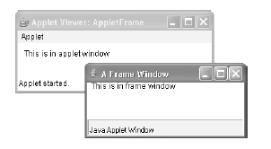
Sample output from this program is shown here:
Anisha P Rodrigues, Dept of CSE, NMAMIT, Nitte

Slide 37
Handling Events in a Frame Window…
// Handle mouse events in both child and applet windows.
import java.awt.*;
import java.awt.event.*;
import java.applet.*;
/* <applet code="WindowEvents" width=300 height=50> </applet>*/
// Create a subclass of Frame.
class SampleFrame extends Frame implements MouseListener, MouseMotionListener {
String msg = "";
int mouseX=10, mouseY=40;
int movX=0, movY=0;
Anisha P Rodrigues, Dept of CSE, NMAMIT, Nitte

Slide 38
SampleFrame(String title) {
super(title);
// register this object to receive its own mouse events
addMouseListener(this);
addMouseMotionListener(this);
// create an object to handle window events
MyWindowAdapter adapter = new MyWindowAdapter(this);
// register it to receive those events
addWindowListener(adapter);
}
// Handle mouse clicked.
public void mouseClicked(MouseEvent me) {
}
Anisha P Rodrigues, Dept of CSE, NMAMIT, Nitte

Slide 39
// Handle mouse entered.
public void mouseEntered(MouseEvent evtObj) {
// save coordinates
mouseX = 10;
mouseY = 54;
msg = "Mouse just entered child.";
repaint();
}
// Handle mouse exited.
public void mouseExited(MouseEvent evtObj) {
// save coordinates
mouseX = 10;
mouseY = 54;
msg = "Mouse just left child window.";
repaint();
}
Anisha P Rodrigues, Dept of CSE, NMAMIT, Nitte

Slide 40
// Handle mouse pressed.
public void mousePressed(MouseEvent me) {
// save coordinates
mouseX = me.getX();
mouseY = me.getY();
msg = "Down";
repaint();
}
// Handle mouse released.
public void mouseReleased(MouseEvent me) {
// save coordinates
mouseX = me.getX();
mouseY = me.getY();
msg = "Up";
repaint();
}
Anisha P Rodrigues, Dept of CSE, NMAMIT, Nitte

Slide 41
// Handle mouse dragged.
public void mouseDragged(MouseEvent me) {
// save coordinates
mouseX = me.getX();
mouseY = me.getY();
movX = me.getX();
movY = me.getY();
msg = "*";
repaint();
}
public void mouseMoved(MouseEvent me) { // Handle mouse moved.
movX = me.getX(); // save coordinates
movY = me.getY();
repaint(0, 0, 100, 60);
}
public void paint(Graphics g) {
g.drawString(msg, mouseX, mouseY);
g.drawString("Mouse at " + movX + ", " + movY, 10, 40);
}
}
Anisha P Rodrigues, Dept of CSE, NMAMIT, Nitte

Slide 42
class MyWindowAdapter extends WindowAdapter {
SampleFrame sampleFrame;
public MyWindowAdapter(SampleFrame sampleFrame) {
this.sampleFrame = sampleFrame;
}
public void windowClosing(WindowEvent we) {
sampleFrame.setVisible(false);
}
}
Anisha P Rodrigues, Dept of CSE, NMAMIT, Nitte

Slide 43
// Applet window.
public class WindowEvents extends Applet implements MouseListener, MouseMotionListener {
SampleFrame f;
String msg = "";
int mouseX=0, mouseY=10;
int movX=0, movY=0;
// Create a frame window.
public void init() {
f = new SampleFrame("Handle Mouse Events");
f.setSize(300, 200);
f.setVisible(true);
// register this object to receive its own mouse events
addMouseListener(this);
addMouseMotionListener(this);
}
Anisha P Rodrigues, Dept of CSE, NMAMIT, Nitte

Slide 44
// Remove frame window when stopping applet.
public void stop() {
f.setVisible(false);
}
// Show frame window when starting applet.
public void start() {
f.setVisible(true);
}
// Handle mouse clicked.
public void mouseClicked(MouseEvent me) {
}
// Handle mouse entered.
public void mouseEntered(MouseEvent me) {
// save coordinates
mouseX = 0;
mouseY = 24;
msg = "Mouse just entered applet window.";
repaint();
}
Anisha P Rodrigues, Dept of CSE, NMAMIT, Nitte

Slide 45
// Handle mouse exited.
public void mouseExited(MouseEvent me) {
// save coordinates
mouseX = 0;
mouseY = 24;
msg = "Mouse just left applet window.";
repaint();
}
// Handle button pressed.
public void mousePressed(MouseEvent me) {
// save coordinates
mouseX = me.getX();
mouseY = me.getY();
msg = "Down";
repaint();
}
Anisha P Rodrigues, Dept of CSE, NMAMIT, Nitte

Slide 46
// Handle button released.
public void mouseReleased(MouseEvent me) {
// save coordinates
mouseX = me.getX();
mouseY = me.getY();
msg = "Up";
repaint();
}
// Handle mouse dragged.
public void mouseDragged(MouseEvent me) {
// save coordinates
mouseX = me.getX();
mouseY = me.getY();
movX = me.getX();
movY = me.getY();
msg = "*";
repaint();
}
Anisha P Rodrigues, Dept of CSE, NMAMIT, Nitte

Slide 47
// Handle mouse moved.
public void mouseMoved(MouseEvent me) {
// save coordinates
movX = me.getX();
movY = me.getY();
repaint(0, 0, 100, 20);
}
// Display msg in applet window.
public void paint(Graphics g) {
g.drawString(msg, mouseX, mouseY);
g.drawString("Mouse at " + movX + ", " + movY, 0, 10);
}
}
Anisha P Rodrigues, Dept of CSE, NMAMIT, Nitte

Slide 48
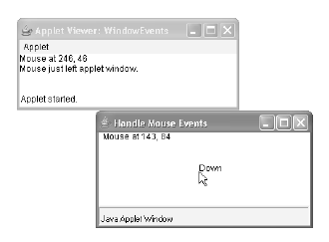
Sample output from this program is shown here:
Anisha P Rodrigues, Dept of CSE, NMAMIT, Nitte

Slide 49
Creating a Windowed Program…
Although creating applets is a common use for Java’s AWT, it is also possible to create stand-alone AWT-based applications
To do this, simply create an instance of the window or windows you need inside main()
The following program creates a frame window that responds to mouse clicks and keystrokes:
Anisha P Rodrigues, Dept of CSE, NMAMIT, Nitte

Slide 50
// Create an AWT-based application.
import java.awt.*;
import java.awt.event.*;
import java.applet.*;
// Create a frame window.
public class AppWindow extends Frame {
String keymsg = "This is a test.";
String mousemsg = "";
int mouseX=30, mouseY=30;
public AppWindow() {
addKeyListener(new MyKeyAdapter(this));
addMouseListener(new MyMouseAdapter(this));
addWindowListener(new MyWindowAdapter());
}
public void paint(Graphics g) {
g.drawString(keymsg, 10, 40);
g.drawString(mousemsg, mouseX, mouseY);
}
Anisha P Rodrigues, Dept of CSE, NMAMIT, Nitte

Slide 51
// Create the window.
public static void main(String args[]) {
AppWindow appwin = new AppWindow();
appwin.setSize(new Dimension(300, 200));
appwin.setTitle("An AWT-Based Application");
appwin.setVisible(true);
}
}
Anisha P Rodrigues, Dept of CSE, NMAMIT, Nitte

Slide 52
class MyKeyAdapter extends KeyAdapter {
AppWindow appWindow;
public MyKeyAdapter(AppWindow appWindow) {
this.appWindow = appWindow;
}
public void keyTyped(KeyEvent ke) {
appWindow.keymsg += ke.getKeyChar();
appWindow.repaint();
};
}
Anisha P Rodrigues, Dept of CSE, NMAMIT, Nitte

Slide 53
class MyMouseAdapter extends MouseAdapter {
AppWindow appWindow;
public MyMouseAdapter(AppWindow appWindow) {
this.appWindow = appWindow;
}
public void mousePressed(MouseEvent me) {
appWindow.mouseX = me.getX();
appWindow.mouseY = me.getY();
appWindow.mousemsg = "Mouse Down at " + appWindow.mouseX +
", " + appWindow.mouseY;
appWindow.repaint();
}
}
Anisha P Rodrigues, Dept of CSE, NMAMIT, Nitte

Slide 54
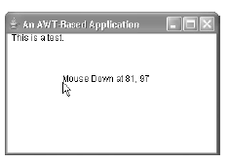
class MyWindowAdapter extends WindowAdapter {
public void windowClosing(WindowEvent we) {
System.exit(0);
}
}
Sample output from this program is shown here:
Anisha P Rodrigues, Dept of CSE, NMAMIT, Nitte

Slide 55
Working with Graphics…
The AWT supports a rich assortment of graphics methods
All graphics are drawn relative to a window
This can be the main window of an applet, a child window of an applet, or a stand-alone application window
The origin of each window is at the top-left corner and is 0,0
Anisha P Rodrigues, Dept of CSE, NMAMIT, Nitte

Slide 56
Coordinates are specified in pixels
All output to a window takes place through a graphics context
A graphics context is encapsulated by the Graphics class and is obtained in two ways:
  It is passed to an applet when one of its various methods, such as paint() or update(), is called
  It is returned by the getGraphics() method of Component
Anisha P Rodrigues, Dept of CSE, NMAMIT, Nitte

Slide 57
Drawing Lines…
Lines are drawn by means of the drawLine() method:
void drawLine(int startX, int startY, int endX, int endY)
drawLine( ) displays a line in the current drawing color that begins at startX, startY and ends at endX, endY
Anisha P Rodrigues, Dept of CSE, NMAMIT, Nitte

Slide 58
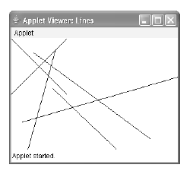
// Draw lines
import java.awt.*;
import java.applet.*;
/*
<applet code="Lines" width=300 height=200></applet>
*/
public class Lines extends Applet {
public void paint(Graphics g) {
g.drawLine(0, 0, 100, 100);
g.drawLine(0, 100, 100, 0);
g.drawLine(40, 25, 250, 180);
g.drawLine(75, 90, 400, 400);
g.drawLine(20, 150, 400, 40);
g.drawLine(5, 290, 80, 19);
}
}
Anisha P Rodrigues, Dept of CSE, NMAMIT, Nitte

Slide 59
Drawing Rectangles…
The drawRect( ) and fillRect( ) methods display an outlined and filled rectangle, respectively
void drawRect(int top, int left, int width, int height)
void fillRect(int top, int left, int width, int height)
The upper-left corner of the rectangle is at top, left
The dimensions of the rectangle are specified by width and height
Anisha P Rodrigues, Dept of CSE, NMAMIT, Nitte

Slide 60
To draw a rounded rectangle, use drawRoundRect( ) or fillRoundRect( )
void drawRoundRect(int top, int left, int width, int height, int xDiam, int yDiam)
void fillRoundRect(int top, int left, int width, int height, int xDiam, int yDiam)
Anisha P Rodrigues, Dept of CSE, NMAMIT, Nitte

Slide 61
The upper-left corner of the rectangle is at top, left
The dimensions of the rectangle are specified by width and height
The diameter of the rounding arc along the X axis is specified by xDiam
The diameter of the rounding arc along the Y axis is specified by yDiam
Anisha P Rodrigues, Dept of CSE, NMAMIT, Nitte

Slide 62
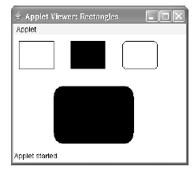
// Draw rectangles
import java.awt.*;
import java.applet.*;
/*
<applet code="Rectangles" width=300 height=200> </applet>
*/
public class Rectangles extends Applet {
public void paint(Graphics g) {
g.drawRect(10, 10, 60, 50);
g.fillRect(100, 10, 60, 50);
g.drawRoundRect(190, 10, 60, 50, 15, 15);
g.fillRoundRect(70, 90, 140, 100, 30, 40);
}
}
Anisha P Rodrigues, Dept of CSE, NMAMIT, Nitte

Slide 63
Drawing Ellipses and Circles…
To draw an ellipse, use drawOval( )
To fill an ellipse, use fillOval( )
void drawOval(int top, int left, int width, int height)
void fillOval(int top, int left, int width, int height)
Anisha P Rodrigues, Dept of CSE, NMAMIT, Nitte

Slide 64
The ellipse is drawn within a bounding rectangle whose upper-left corner is specified by top, left and whose width and height are specified by width and height
To draw a circle, specify a square as the bounding rectangle
Anisha P Rodrigues, Dept of CSE, NMAMIT, Nitte

Slide 65
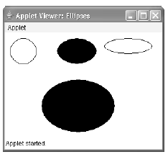
// Draw Ellipses
import java.awt.*;
import java.applet.*;
/*
<applet code="Ellipses" width=300 height=200> </applet>
*/
public class Ellipses extends Applet {
public void paint(Graphics g) {
g.drawOval(10, 10, 50, 50);
g.fillOval(100, 10, 75, 50);
g.drawOval(190, 10, 90, 30);
g.fillOval(70, 90, 140, 100);
}
}
Anisha P Rodrigues, Dept of CSE, NMAMIT, Nitte

Slide 66
Drawing Arcs…
Arcs can be drawn with drawArc( ) and fillArc( )
void drawArc(int top, int left, int width, int height, int startAngle, int sweepAngle)
void fillArc(int top, int left, int width, int height, int startAngle, int sweepAngle)
Anisha P Rodrigues, Dept of CSE, NMAMIT, Nitte

Slide 67
The arc is bounded by the rectangle whose upper-left corner is specified by top, left and whose width and height are specified by width and height
The arc is drawn from startAngle through the angular distance specified by sweepAngle
Angles are specified in degrees
Anisha P Rodrigues, Dept of CSE, NMAMIT, Nitte

Slide 68
Zero degrees is on the horizontal, at the three o’clock position
The arc is drawn counterclockwise if sweepAngle is positive, and clockwise if sweepAngle is negative
Therefore, to draw an arc from twelve o’clock to six o’clock, the start angle would be 90 and the sweep angle 180
Anisha P Rodrigues, Dept of CSE, NMAMIT, Nitte

Slide 69
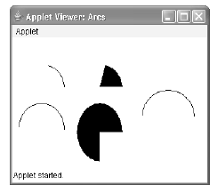
// Draw Arcs
import java.awt.*;
import java.applet.*;
/*
<applet code="Arcs" width=300 height=200> </applet>
*/
public class Arcs extends Applet {
public void paint(Graphics g) {
g.drawArc(10, 40, 70, 70, 0, 75);
g.fillArc(100, 40, 70, 70, 0, 75);
g.drawArc(10, 100, 70, 80, 0, 175);
g.fillArc(100, 100, 70, 90, 0, 270);
g.drawArc(200, 80, 80, 80, 0, 180);
}
}
Anisha P Rodrigues, Dept of CSE, NMAMIT, Nitte

Slide 70
Drawing Polygons…
void drawPolygon(int x[ ], int y[ ], int numPoints)
void fillPolygon(int x[ ], int y[ ], int numPoints)
The polygon’s endpoints are specified by the coordinate pairs contained within the x and y arrays
The number of points defined by x and y is specified by numPoints
Anisha P Rodrigues, Dept of CSE, NMAMIT, Nitte

Slide 71
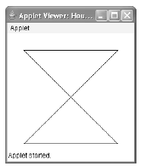
// Draw Polygon
import java.awt.*;
import java.applet.*;
/*
<applet code="HourGlass" width=230 height=210>
</applet>
*/
public class HourGlass extends Applet {
public void paint(Graphics g) {
int xpoints[] = {30, 200, 30, 200, 30};
int ypoints[] = {30, 30, 200, 200, 30};
int num = 5;
g.drawPolygon(xpoints, ypoints, num);
}
}
Anisha P Rodrigues, Dept of CSE, NMAMIT, Nitte

Slide 72
Sizing Graphics…
Often, you will want to size a graphics object to fit the current size of the window in which it is drawn
To do so, first obtain the current dimensions of the window by calling getSize( ) on the window object
It returns the dimensions of the window encapsulated within a Dimension object
Once you have the current size of the window, you can scale your graphical output accordingly
Anisha P Rodrigues, Dept of CSE, NMAMIT, Nitte

Slide 73
Here is an applet that will start as a 200×200 pixel square and grow by 25 pixels in width and height with each mouse click until the applet gets larger than 500×500
At that point, the next click will return it to 200×200, and the process starts over
Anisha P Rodrigues, Dept of CSE, NMAMIT, Nitte

Slide 74
// Resizing output to fit the current size of a window.
import java.applet.*;
import java.awt.*;
import java.awt.event.*;
/*
<applet code="ResizeMe" width=200 height=200>
</applet>
*/
public class ResizeMe extends Applet {
final int inc = 25;
int max = 500;
int min = 200;
Dimension d;
Anisha P Rodrigues, Dept of CSE, NMAMIT, Nitte

Slide 75
public ResizeMe() {
addMouseListener(new MouseAdapter() {
public void mouseReleased(MouseEvent me) {
int w = (d.width + inc) > max?min :(d.width + inc);
int h = (d.height + inc) > max?min :(d.height + inc);
setSize(new Dimension(w, h));
}
});
}
public void paint(Graphics g) {
d = getSize();
g.drawLine(0, 0, d.width-1, d.height-1);
g.drawLine(0, d.height-1, d.width-1, 0);
g.drawRect(0, 0, d.width-1, d.height-1);
}
}
Anisha P Rodrigues, Dept of CSE, NMAMIT, Nitte

Slide 76
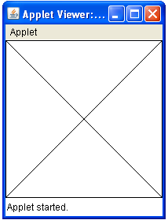
Anisha P Rodrigues, Dept of CSE, NMAMIT, Nitte

Slide 77
Working with Color…
Java supports color in a portable, device-independent fashion
The AWT color system allows you to specify any color you want
It then finds the best match for that color, given the limits of the display hardware currently executing your program or applet
Thus, your code does not need to be concerned with the differences in the way color is supported by various hardware devices
Anisha P Rodrigues, Dept of CSE, NMAMIT, Nitte

Slide 78
Color is encapsulated by the Color class
You can also create your own colors, using one of the color constructors
Three commonly used forms are shown here:
Color(int red, int green, int blue)
Color(int rgbValue)
Color(float red, float green, float blue)
Anisha P Rodrigues, Dept of CSE, NMAMIT, Nitte

Slide 79
The first constructor takes three integers that specify the color as a mix of red, green, and blue
These values must be between 0 and 255, as in this example:
new Color(255, 100, 100); // light red
Anisha P Rodrigues, Dept of CSE, NMAMIT, Nitte

Slide 80
The second color constructor takes a single integer that contains the mix of red, green, and blue packed into an integer
The integer is organized with red in bits 16 to 23, green in bits 8 to 15, and blue in bits 0 to 7
Example of this constructor:
int newRed = (0xff000000 | (0xc0 << 16) | (0x00 << 8) | 0x00);
Color darkRed = new Color(newRed);
Anisha P Rodrigues, Dept of CSE, NMAMIT, Nitte

Slide 81
The final constructor, Color(float, float, float), takes three float values (between 0.0 and 1.0) that specify the relative mix of red, green, and blue
    Color clr1 = new Color(0.85, 0.2, 0.36); // some color shade
    Color clr2 = new Color(1.0, 0, 0); // pure red color
    Color clr3 = new Color(1.0, 1.0, 1.0); // white
    Color clr4 = new Color(0.0, 0.0, 0.0); // black
Once you have created a color, you can use it to set the foreground and/or background color by using the setForeground() and setBackground() methods
Anisha P Rodrigues, Dept of CSE, NMAMIT, Nitte

Slide 82
Color Methods…
Anisha P Rodrigues, Dept of CSE, NMAMIT, Nitte

Slide 83
Using Hue, Saturation, and Brightness…
The hue-saturation-brightness (HSB) color model is an alternative to red-green-blue (RGB) for specifying particular colors
Figuratively, hue is a wheel of color
The hue is specified with a number between 0.0 and 1.0 (the colors are approximately red, orange, yellow, green, blue, indigo, and violet).
Anisha P Rodrigues, Dept of CSE, NMAMIT, Nitte

Slide 84
Saturation is another scale ranging from 0.0 to 1.0, representing light pastels to intense hues. Brightness values also range from 0.0 to 1.0, where 1 is bright white and 0 is black
Anisha P Rodrigues, Dept of CSE, NMAMIT, Nitte

Slide 85
Color supplies two methods that let you convert between RGB and HSB
They are shown here:
static int HSBtoRGB(float hue, float saturation, float brightness)
static float[ ] RGBtoHSB(int red, int green, int blue, float values[ ])
Anisha P Rodrigues, Dept of CSE, NMAMIT, Nitte

Slide 86
HSBtoRGB( ) returns a packed RGB value compatible with the Color(int) constructor
RGBtoHSB( ) returns a float array of HSB values corresponding to RGB integers
If values is not null, then this array is given the HSB values and returned
Otherwise, a new array is created and the HSB values are returned in it; In either case, the array contains the hue at index 0, saturation at index 1, and brightness at index 2
Anisha P Rodrigues, Dept of CSE, NMAMIT, Nitte

Slide 87
getRed( ), getGreen( ), getBlue( )
We can obtain the red, green, and blue components of a color independently using getRed(), getGreen(), and getBlue():
int getRed( )
int getGreen( )
int getBlue( )
Each of these methods returns the RGB color component found in the invoking Color object in the lower 8 bits of an integer
Anisha P Rodrigues, Dept of CSE, NMAMIT, Nitte

Slide 88
getRGB( ) - To obtain a packed, RGB representation of a color, use getRGB( ):
int getRGB( )
Anisha P Rodrigues, Dept of CSE, NMAMIT, Nitte

Slide 89
Setting the Current Graphics Color…
By default, graphics objects are drawn in the current foreground color
We can change this color by calling the Graphics method setColor( )
void setColor(Color newColor)
Here, newColor specifies the new drawing color
Anisha P Rodrigues, Dept of CSE, NMAMIT, Nitte

Slide 90
You can obtain the current color by calling getColor( ), shown here:
Color getColor( )
Anisha P Rodrigues, Dept of CSE, NMAMIT, Nitte

Slide 91
A Color Demonstration Applet…
// Demonstrate color.
import java.awt.*;
import java.applet.*;
/* <applet code="ColorDemo" width=300 height=200> </applet> */
public class ColorDemo extends Applet {
// draw lines
public void paint(Graphics g) {
Color c1 = new Color(255, 100, 100);
Color c2 = new Color(100, 255, 100);
Color c3 = new Color(100, 100, 255);
Anisha P Rodrigues, Dept of CSE, NMAMIT, Nitte

Slide 92
g.setColor(c1);
g.drawLine(0, 0, 100, 100);
g.drawLine(0, 100, 100, 0);
g.setColor(c2);
g.drawLine(40, 25, 250, 180);
g.drawLine(75, 90, 400, 400);
g.setColor(c3);
g.drawLine(20, 150, 400, 40);
g.drawLine(5, 290, 80, 19);
Anisha P Rodrigues, Dept of CSE, NMAMIT, Nitte

Slide 93
g.setColor(Color.red);
g.drawOval(10, 10, 50, 50);
g.fillOval(70, 90, 140, 100);
g.setColor(Color.blue);
g.drawOval(190, 10, 90, 30);
g.drawRect(10, 10, 60, 50);
g.setColor(Color.cyan);
g.fillRect(100, 10, 60, 50);
g.drawRoundRect(190, 10, 60, 50, 15, 15);
}
}
Anisha P Rodrigues, Dept of CSE, NMAMIT, Nitte

Slide 94
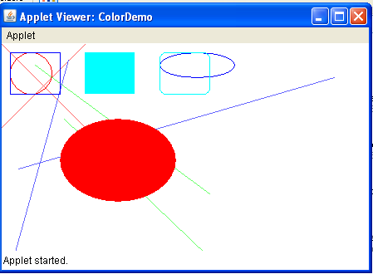
Anisha P Rodrigues, Dept of CSE, NMAMIT, Nitte

Slide 95
Setting the Paint Mode…
The paint mode determines how objects are drawn in a window
By default, new output to a window overwrites any preexisting contents
Anisha P Rodrigues, Dept of CSE, NMAMIT, Nitte

Slide 96
However, it is possible to have new objects XORed onto the window by using setXORMode()
void setXORMode(Color xorColor)
Here, xorColor specifies the color that will be XORed to the window when an object is drawn
Anisha P Rodrigues, Dept of CSE, NMAMIT, Nitte

Slide 97
The advantage of XOR mode is that the new object is always guaranteed to be visible no matter what color the object is drawn over
To return to overwrite mode, call setPaintMode( )
void setPaintMode( )
In general, you will want to use overwrite mode for normal output, and XOR mode for special purposes
Anisha P Rodrigues, Dept of CSE, NMAMIT, Nitte

Slide 98
For example, the following program displays cross hairs that track the mouse pointer
The cross hairs are XORed onto the window and are always visible, no matter what the underlying color is
Anisha P Rodrigues, Dept of CSE, NMAMIT, Nitte

Slide 99
import java.awt.*;
import java.awt.event.*;
import java.applet.*;
/*<applet code="XOR" width=400 height=200></applet>*/
public class XOR extends Applet {
int chsX=100, chsY=100;
public XOR() {
addMouseMotionListener(new MouseMotionAdapter() {
public void mouseMoved(MouseEvent me) {
int x = me.getX();
int y = me.getY();
chsX = x-10;
chsY = y-10;
repaint();
} });
}
Anisha P Rodrigues, Dept of CSE, NMAMIT, Nitte

Slide 100
public void paint(Graphics g) {
g.drawLine(0, 0, 100, 100);
g.drawLine(0, 100, 100, 0);
g.setColor(Color.blue);
g.drawLine(40, 25, 250, 180);
g.drawLine(75, 90, 400, 400);
g.setColor(Color.green);
g.drawRect(10, 10, 60, 50);
g.fillRect(100, 10, 60, 50);
g.setColor(Color.red);
g.drawRoundRect(190, 10, 60, 50, 15, 15);
g.fillRoundRect(70, 90, 140, 100, 30, 40);
g.setColor(Color.cyan);
g.drawLine(20, 150, 400, 40);
g.drawLine(5, 290, 80, 19);
Anisha P Rodrigues, Dept of CSE, NMAMIT, Nitte

Slide 101
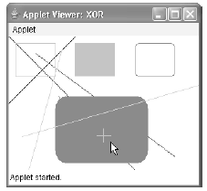
// xor cross hairs
g.setXORMode(Color.black);
g.drawLine(chsX-10, chsY, chsX+10, chsY);
g.drawLine(chsX, chsY-10, chsX, chsY+10);
g.setPaintMode();
}
}
Anisha P Rodrigues, Dept of CSE, NMAMIT, Nitte

Slide 102
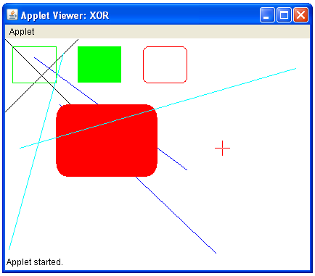
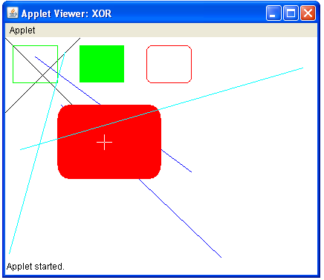
Anisha P Rodrigues, Dept of CSE, NMAMIT, Nitte

Slide 103
Working with Fonts…
Anisha P Rodrigues, Dept of CSE, NMAMIT, Nitte

Slide 104
The AWT supports multiple type fonts
The AWT provides flexibility by abstracting font-manipulation operations and allowing for dynamic selection of fonts
Fonts have a family name, a logical font name, and a face name
Anisha P Rodrigues, Dept of CSE, NMAMIT, Nitte

Slide 105
The family name is the general name of the font, such as Courier
The logical name specifies a category of font, such as Monospaced
The face name specifies a specific font, such as Courier Italic
Fonts are encapsulated by the Font class
Anisha P Rodrigues, Dept of CSE, NMAMIT, Nitte

Slide 106
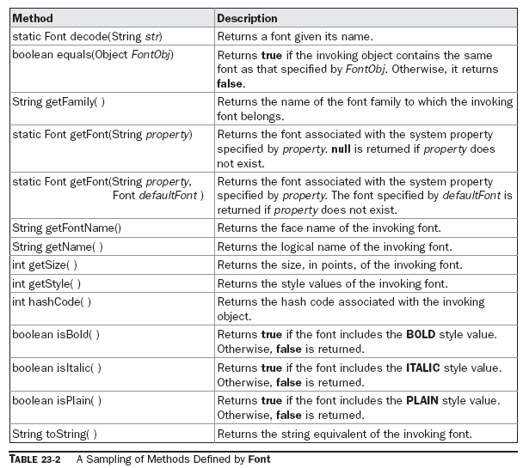
Anisha P Rodrigues, Dept of CSE, NMAMIT, Nitte

Slide 107
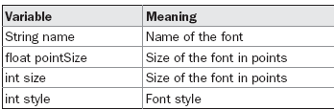
The Font class defines these variables:
Anisha P Rodrigues, Dept of CSE, NMAMIT, Nitte

Slide 108
Determining the Available Fonts…
When working with fonts, often you need to know which fonts are available on your machine
To obtain this information, you can use the getAvailableFontFamilyNames( ) method defined by the GraphicsEnvironment class
String[ ] getAvailableFontFamilyNames( )
This method returns an array of strings that contains the names of the available font families
Anisha P Rodrigues, Dept of CSE, NMAMIT, Nitte

Slide 109
In addition, the getAllFonts( ) method is defined by the GraphicsEnvironment class
Font[ ] getAllFonts( )
This method returns an array of Font objects for all of the available fonts
Anisha P Rodrigues, Dept of CSE, NMAMIT, Nitte

Slide 110
Since these methods are members of GraphicsEnvironment, you need a GraphicsEnvironment reference to call them
You can obtain this reference by using the getLocalGraphicsEnvironment( ) static method, which is defined by GraphicsEnvironment
static GraphicsEnvironment getLocalGraphicsEnvironment( )
Anisha P Rodrigues, Dept of CSE, NMAMIT, Nitte

Slide 111
// Display Fonts
/* <applet code="ShowFonts" width=550 height=60> </applet> */
import java.applet.*;
import java.awt.*;
public class ShowFonts extends Applet {
public void paint(Graphics g) {
String msg = "";
String FontList[];
GraphicsEnvironment ge =
GraphicsEnvironment.getLocalGraphicsEnvironment();
FontList = ge.getAvailableFontFamilyNames();
for(int i = 0; i < FontList.length; i++)
msg += FontList[i] + " ";
g.drawString(msg, 4, 16);
}
}
Anisha P Rodrigues, Dept of CSE, NMAMIT, Nitte

Slide 112
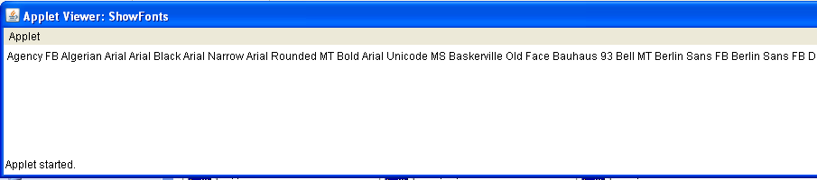
Anisha P Rodrigues, Dept of CSE, NMAMIT, Nitte

Slide 113
Creating and Selecting a Font…
To select a new font, you must first construct a Font object that describes that font
Font constructor has this general form:
Font(String fontName, int fontStyle, int pointSize)
Here, fontName specifies the name of the desired font
Anisha P Rodrigues, Dept of CSE, NMAMIT, Nitte

Slide 114
The name can be specified using either the logical or face name
All Java environments will support the following fonts: Dialog, DialogInput, Sans Serif, Serif, and Monospaced
Dialog is the font used by your system’s dialog boxes
Dialog is also the default if you don’t explicitly set a font
Anisha P Rodrigues, Dept of CSE, NMAMIT, Nitte

Slide 115
The style of the font is specified by fontStyle
It may consist of one or more of these three constants: Font.PLAIN, Font.BOLD, and Font.ITALIC
To combine styles, OR them together
For example, Font.BOLD | Font.ITALIC specifies a bold, italics style
The size, in points, of the font is specified by pointSize.
Anisha P Rodrigues, Dept of CSE, NMAMIT, Nitte

Slide 116
To use a font that you have created, you must select it using setFont(), which is defined by Component
It has this general form:
void setFont(Font fontObj)
Here, fontObj is the object that contains the desired font
Anisha P Rodrigues, Dept of CSE, NMAMIT, Nitte

Slide 117
The following program outputs a sample of each standard font
Each time you click the mouse within its window, a new font is selected and its name is displayed.
Anisha P Rodrigues, Dept of CSE, NMAMIT, Nitte

Slide 118
import java.applet.*;
import java.awt.*;
import java.awt.event.*;
/*<applet code="SampleFonts" width=200 height=100></applet>*/
public class SampleFonts extends Applet {
int next = 0;
Font f;
String msg;
public void init() {
f = new Font("Dialog", Font.PLAIN, 12);
msg = "Dialog";
setFont(f);
addMouseListener(new MyMouseAdapter(this));
}
public void paint(Graphics g) {
g.drawString(msg, 4, 20);
}
}
Anisha P Rodrigues, Dept of CSE, NMAMIT, Nitte

Slide 119
class MyMouseAdapter extends MouseAdapter {
SampleFonts sampleFonts;
public MyMouseAdapter(SampleFonts sampleFonts) {
this.sampleFonts = sampleFonts;
}
public void mousePressed(MouseEvent me) {
// Switch fonts with each mouse click.
sampleFonts.next++;
switch(sampleFonts.next) {
case 0:
sampleFonts.f = new Font("Dialog", Font.PLAIN, 12);
sampleFonts.msg = "Dialog";
break;
case 1:
sampleFonts.f = new Font("DialogInput", Font.PLAIN, 12);
sampleFonts.msg = "DialogInput";
break;
Anisha P Rodrigues, Dept of CSE, NMAMIT, Nitte

Slide 120
case 2:
sampleFonts.f = new Font("SansSerif", Font.PLAIN, 12);
sampleFonts.msg = "SansSerif";
break;
case 3:
sampleFonts.f = new Font("Serif", Font.PLAIN, 12);
sampleFonts.msg = "Serif";
break;
case 4:
sampleFonts.f = new Font("Monospaced", Font.PLAIN, 12);
sampleFonts.msg = "Monospaced";
break;
}
if(sampleFonts.next == 4) sampleFonts.next = -1;
sampleFonts.setFont(sampleFonts.f);
sampleFonts.repaint();
}
}
Anisha P Rodrigues, Dept of CSE, NMAMIT, Nitte

Slide 121
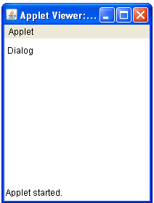
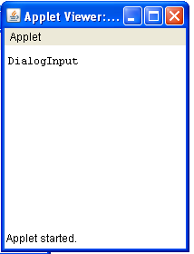
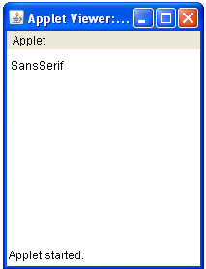
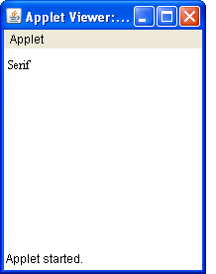
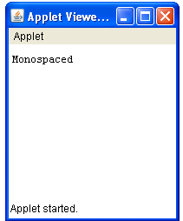
Anisha P Rodrigues, Dept of CSE, NMAMIT, Nitte

Slide 122
Obtaining Font Information…
Suppose you want to obtain information about the currently selected font
To do this, you must first get the current font by calling getFont( )
This method is defined by the Graphics class:
Font getFont( )
Anisha P Rodrigues, Dept of CSE, NMAMIT, Nitte

Slide 123
Once you have obtained the currently selected font, you can retrieve information about it using various methods defined by Font
Anisha P Rodrigues, Dept of CSE, NMAMIT, Nitte

Slide 124
// Display font info.
import java.applet.*;
import java.awt.*;
/*<applet code="FontInfo" width=350 height=60></applet>*/
public class FontInfo extends Applet {
public void paint(Graphics g) {
Font f = g.getFont();
String fontName = f.getName();
String fontFamily = f.getFamily();
int fontSize = f.getSize();
int fontStyle = f.getStyle();
Anisha P Rodrigues, Dept of CSE, NMAMIT, Nitte

Slide 125
String msg = "Family: " + fontName;
msg += ", Font: " + fontFamily;
msg += ", Size: " + fontSize + ", Style: ";
if((fontStyle & Font.BOLD) == Font.BOLD)
msg += "Bold ";
if((fontStyle & Font.ITALIC) == Font.ITALIC)
msg += "Italic ";
if((fontStyle & Font.PLAIN) == Font.PLAIN)
msg += "Plain ";
g.drawString(msg, 4, 16);
}
}
Anisha P Rodrigues, Dept of CSE, NMAMIT, Nitte

Slide 126
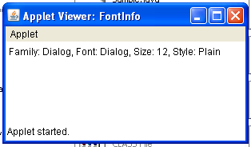
Anisha P Rodrigues, Dept of CSE, NMAMIT, Nitte

Slide 127
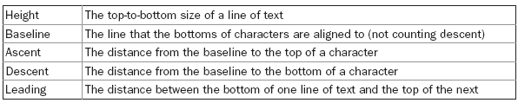
Managing Text Output Using FontMetrics
Common terminology used when describing fonts:
Anisha P Rodrigues, Dept of CSE, NMAMIT, Nitte

Slide 128
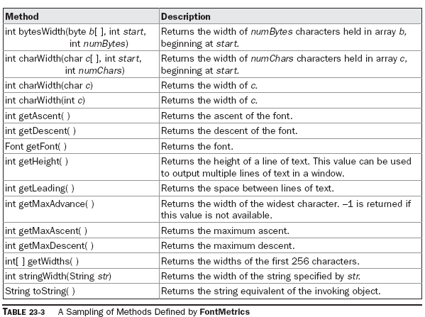
Anisha P Rodrigues, Dept of CSE, NMAMIT, Nitte

Slide 129
Displaying Multiple Lines of Text…
The most common use of FontMetrics is to determine the spacing between lines of text
The second most common use is to determine the length of a string that is being displayed
Anisha P Rodrigues, Dept of CSE, NMAMIT, Nitte

Slide 130
In general, to display multiple lines of text, your program must manually keep track of the current output position
Each time a newline is desired, the Y coordinate must be advanced to the beginning of the next line
Each time a string is displayed, the X coordinate must be set to the point at which the string ends
This allows the next string to be written so that it begins at the end of the preceding one
Anisha P Rodrigues, Dept of CSE, NMAMIT, Nitte

Slide 131
To determine the spacing between lines, we can use the value returned by getLeading( )
To determine the total height of the font, add the value returned by getAscent( ) to the value returned by getDescent( )
We can then use these values to position each line of text you output
Anisha P Rodrigues, Dept of CSE, NMAMIT, Nitte

Slide 132
However, in many cases, you will not need to use these individual values
Often, all that you will need to know is the total height of a line, which is the sum of the leading space and the font’s ascent and descent values
The easiest way to obtain this value is to call getHeight( )
Simply increment the Y coordinate by this value each time you want to advance to the next line when outputting text
Anisha P Rodrigues, Dept of CSE, NMAMIT, Nitte

Slide 133
To start output at the end of previous output on the same line, you must know the length, in pixels, of each string that you display
To obtain this value, call stringWidth( )
You can use this value to advance the X coordinate each time you display a line
Anisha P Rodrigues, Dept of CSE, NMAMIT, Nitte

Slide 134
The following applet shows how to output multiple lines of text in a window
It also displays multiple sentences on the same line. Notice the variables curX and curY
They keep track of the current text output position
Anisha P Rodrigues, Dept of CSE, NMAMIT, Nitte

Slide 135
// Demonstrate multiline output.
import java.applet.*;
import java.awt.*;
/*<applet code="MultiLine" width=300 height=100></applet>*/
public class MultiLine extends Applet {
int curX=0, curY=0; // current position
public void init() {
Font f = new Font("SansSerif", Font.PLAIN, 12);
setFont(f);
}
public void paint(Graphics g) {
FontMetrics fm = g.getFontMetrics();
nextLine("This is on line one.", g);
nextLine("This is on line two.", g);
sameLine(" This is on same line.", g);
sameLine(" This, too.", g);
nextLine("This is on line three.", g);
}
Anisha P Rodrigues, Dept of CSE, NMAMIT, Nitte

Slide 136
// Advance to next line.
void nextLine(String s, Graphics g) {
FontMetrics fm = g.getFontMetrics();
curY += fm.getHeight(); // advance to next line
curX = 0;
g.drawString(s, curX, curY);
curX = fm.stringWidth(s); // advance to end of line
}
// Display on same line.
void sameLine(String s, Graphics g) {
FontMetrics fm = g.getFontMetrics();
g.drawString(s, curX, curY);
curX += fm.stringWidth(s); // advance to end of line
}
}
Anisha P Rodrigues, Dept of CSE, NMAMIT, Nitte

Slide 137
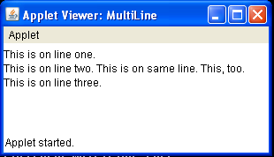
Anisha P Rodrigues, Dept of CSE, NMAMIT, Nitte

Slide 138
Centering Text…
It obtains the ascent, descent, and width of the string and computes the position at which it must be displayed to be centered
Anisha P Rodrigues, Dept of CSE, NMAMIT, Nitte

Slide 139
// Center text.
import java.applet.*;
import java.awt.*;
/*<applet code="CenterText" width=200 height=100></applet>*/
public class CenterText extends Applet {
final Font f = new Font("SansSerif", Font.BOLD, 18);
public void paint(Graphics g) {
Dimension d = this.getSize();
g.setColor(Color.white);
g.fillRect(0, 0, d.width,d.height);
g.setColor(Color.black);
g.setFont(f);
drawCenteredString("This is centered.", d.width, d.height, g);
g.drawRect(0, 0, d.width-1, d.height-1);
}
Anisha P Rodrigues, Dept of CSE, NMAMIT, Nitte

Slide 140
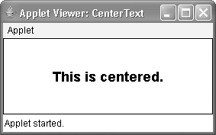
public void drawCenteredString(String s, int w, int h,
Graphics g)
{
FontMetrics fm = g.getFontMetrics();
int x = (w - fm.stringWidth(s)) / 2;
int y = (fm.getAscent() + (h - (fm.getAscent()
+ fm.getDescent()))/2);
g.drawString(s, x, y);
}
}
Anisha P Rodrigues, Dept of CSE, NMAMIT, Nitte

Slide 141
Multiline Text Alignment…
Most word processors can left-justify and/or right-justify text
Most can also center text
Anisha P Rodrigues, Dept of CSE, NMAMIT, Nitte

Slide 142
In the program, the string to be justified is broken into individual words
For each word, the program keeps track of its length in the current font and automatically advances to the next line if the word will not fit on the current line
Each completed line is displayed in the window in the currently selected alignment style
Each time you click the mouse in the applet’s window, the alignment style is changed
Anisha P Rodrigues, Dept of CSE, NMAMIT, Nitte

Slide 143
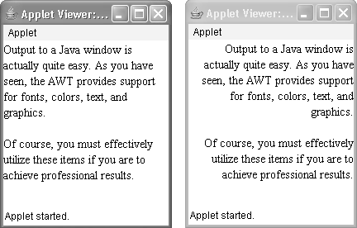
Anisha P Rodrigues, Dept of CSE, NMAMIT, Nitte

Slide 144
// Demonstrate text alignment.
import java.applet.*;
import java.awt.*;
import java.awt.event.*;
import java.util.*;
/* <title>Text Layout</title>
<applet code="TextLayout" width=200 height=200>
<param name="text" value="Output to a Java window is actually
quite easy.
As you have seen, the AWT provides support for
fonts, colors, text, and graphics. <P> Of course,
you must effectively utilize these items
if you are to achieve professional results.">
<param name="fontname" value="Serif">
<param name="fontSize" value="14">
</applet> */
Anisha P Rodrigues, Dept of CSE, NMAMIT, Nitte

Slide 145
public class TextLayout extends Applet {
final int LEFT = 0;
final int RIGHT = 1;
final int CENTER = 2;
final int LEFTRIGHT =3;
int align;
Dimension d;
Font f;
FontMetrics fm;
int fontSize;
int fh, bl;
int space;
String text;
Anisha P Rodrigues, Dept of CSE, NMAMIT, Nitte

Slide 146
public void init() {
setBackground(Color.white);
text = getParameter("text");
try {
fontSize = Integer.parseInt(getParameter("fontSize"));}
catch (NumberFormatException e) {
fontSize=14;
}
align = LEFT;
addMouseListener(new MyMouseAdapter(this));
}
public void paint(Graphics g) {
update(g);
}
Anisha P Rodrigues, Dept of CSE, NMAMIT, Nitte

Slide 147
public void update(Graphics g) {
d = getSize();
g.setColor(getBackground());
g.fillRect(0,0,d.width, d.height);
if(f==null) f = new Font(getParameter("fontname"),
Font.PLAIN, fontSize);
g.setFont(f);
if(fm == null) {
fm = g.getFontMetrics();
bl = fm.getAscent();
fh = bl + fm.getDescent();
space = fm.stringWidth(" ");
}
g.setColor(Color.black);
StringTokenizer st = new StringTokenizer(text);
int x = 0;
int nextx;
int y = 0;
Anisha P Rodrigues, Dept of CSE, NMAMIT, Nitte

Slide 148
String word, sp;
int wordCount = 0;
String line = "";
while (st.hasMoreTokens()) {
word = st.nextToken();
if(word.equals("<P>")) {
drawString(g, line, wordCount,
fm.stringWidth(line), y+bl);
line = "";
wordCount = 0;
x = 0;
y = y + (fh * 2);
}
Anisha P Rodrigues, Dept of CSE, NMAMIT, Nitte

Slide 149
else {
int w = fm.stringWidth(word);
if(( nextx = (x+space+w)) > d.width ) {
drawString(g, line, wordCount,
fm.stringWidth(line), y+bl);
line = "";
wordCount = 0;
x = 0;
y = y + fh;
}
if(x!=0) {sp = " ";} else {sp = "";}
line = line + sp + word;
x = x + space + w;
wordCount++;
}
}
drawString(g, line, wordCount, fm.stringWidth(line), y+bl);
}
Anisha P Rodrigues, Dept of CSE, NMAMIT, Nitte

Slide 150
public void drawString(Graphics g, String line,
int wc, int lineW, int y) {
switch(align) {
case LEFT: g.drawString(line, 0, y);
break;
case RIGHT: g.drawString(line, d.width-lineW ,y);
break;
case CENTER: g.drawString(line, (d.width-lineW)/2, y);
break;
case LEFTRIGHT:
if(lineW < (int)(d.width*.75)) {
g.drawString(line, 0, y);
}
Anisha P Rodrigues, Dept of CSE, NMAMIT, Nitte

Slide 151
else {
int toFill = (d.width - lineW)/wc;
int nudge = d.width - lineW - (toFill*wc);
int s = fm.stringWidth(" ");
StringTokenizer st = new StringTokenizer(line);
int x = 0;
while(st.hasMoreTokens()) {
String word = st.nextToken();
g.drawString(word, x, y);
if(nudge>0) {
x = x + fm.stringWidth(word) + space + toFill + 1;
nudge--;
} else {
x = x + fm.stringWidth(word) + space + toFill;
} } }
break;
} } }
Anisha P Rodrigues, Dept of CSE, NMAMIT, Nitte

Slide 152
class MyMouseAdapter extends MouseAdapter {
TextLayout tl;
public MyMouseAdapter(TextLayout tl) {
this.tl = tl;
}
public void mouseClicked(MouseEvent me) {
tl.align = (tl.align + 1) % 4;
tl.repaint();
}
}
Anisha P Rodrigues, Dept of CSE, NMAMIT, Nitte

Slide 153
The applet first creates several constants that will be used to determine the alignment style, and then declares several variables
The init() method obtains the text that will be displayed
It then initializes the font size in a try-catch block, which will set the font size to 14 if the fontSize parameter is missing from the HTML
The text parameter is a long string of text, with the HTML tag <P> as a paragraph separator
Anisha P Rodrigues, Dept of CSE, NMAMIT, Nitte

Slide 154
The update( ) method is the engine for this example
It sets the font and gets the baseline and font height from a font metrics object
Next, it creates a StringTokenizer and uses it to retrieve the next token (a string separated by whitespace) from the string specified by text
If the next token is <P>, it advances the vertical spacing
Anisha P Rodrigues, Dept of CSE, NMAMIT, Nitte

Slide 155
Otherwise, update( ) checks to see if the length of this token in the current font will go beyond the width of the column
If the line is full of text or if there are no more tokens, the line is output by a custom version of drawString( )
Anisha P Rodrigues, Dept of CSE, NMAMIT, Nitte

Slide 156
The first three cases in drawString( ) are simple
Each aligns the string that is passed in line to the left or right edge or to the center of the column, depending upon the alignment style
The LEFTRIGHT case aligns both the left and right sides of the string
Anisha P Rodrigues, Dept of CSE, NMAMIT, Nitte

Slide 157
This means that we need to calculate the remaining whitespace (the difference between the width of the string and the width of the column) and distribute that space between each of the words
The last method in this class advances the alignment style each time you click the mouse on the applet’s window
Anisha P Rodrigues, Dept of CSE, NMAMIT, Nitte

Slide 158
Thank You…
Anisha P Rodrigues, Dept of CSE, NMAMIT, Nitte

